Slide 1
Group-10 The OG’s
Vatsal Shah-AU2040019 Ushmay Patel-AU2040253
Nihaar Patel-AU2040182 Deep Patel-AU2040250
Project Domain: Markov chains
Project Title: FindiProject Domain: Network Flow
Project Title: Finding stable states of Network Flow used for optimizing
search engine results
g stable states in Markov chains used for optimizing

Slide 2
Background
We all are familiar with web browsing and internet surfing. Have you ever wondered how Google responds so quickly to our search and provides us with results?
Network flow efficiency is the reason why this is possible.
Search engines spend large amounts of money on algorithms and equations to achieve maximum network flow efficiency. We are primarily using a steady-state analysis of network flow.
Steady-state analysis of network flow means analyzing a flow in the network until it reaches a steady-state.

Slide 3
Motivation
One of the most prominent motivations was to understand the approach behind the well-known PageRank algorithm that's used by Google to rank pages.
This process of ranking pages based on whether the user after searching significant terms relates to them stays on a webpage or is directed to some other web page. This was the primary boost to discover some subtle stuff about how the theory of linear algebra is used to rank the web page.
The PageRank algorithm essentially solved the web search problem and was the basis for Google’s success.
We can model this as a graph problem where web pages are vertices and links are edges.

Slide 4
Problem Statement
‘Finding Steady State of a Network flow’.
Page Rank to illustrate the Search Engine Results and asserting the fact that Steady state is one of the Eigenvectors of the Matrix.
The most prominent webpage that we will get after searching will be optimized solution using pagerank algorithm and concept of network flow.

Slide 5
Literature Survey
Programming language to be used: Python
Why:
Python is more effective and uses less time.
It is more readable and is object oriented.
We will be using python libraries such as NumPy and Pandas.
We will use certain concepts such as matrices and eigenvectors.

Slide 6
To access and use these concepts we use tools in python and Matlab and use their respective libraries.
By doing this we will reduce the time for running our program and make use of it efficiently.
The problem of optimizing search results will be minimized.
The steady state also speaks about page rank in which the value of each node which is a web page shows what numbers of visitors are going to stay on a given node and what number are going to transit.

Slide 7
Reproduced Work
Linear Algebra concept that we used for finding eigenvalues and eigenvectors by Jacobi Algorithm.
Then we find matrix in terms of its diagonal matrix and eigenvectors.
We defined two functions diagonalization and inverse function.
Inverse function: To find the inverse of eigenvector matrices using elementary row operations
Diagonalization function: Product of eigenvector matrices, diagonal matrices and inverse of eigenvector matrices.

Slide 8
How PageRank works?
Pagerank is defined as “A classical method used to arrange the web page according to its objective and the usage of terms involved in it on WWW by using any link data structure”.
Pagerank is a “Vote” by all other pages on the web about how important a page is.
A link to the page counts as a vote of support.

Slide 9
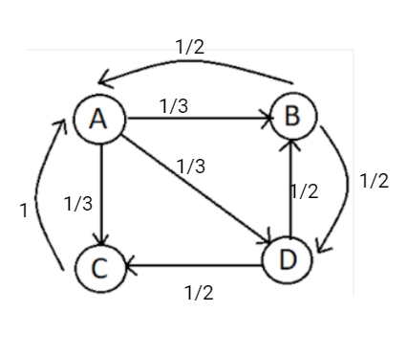
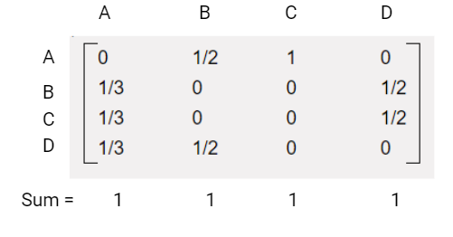
Connection of Web Pages

Slide 10
In the above figure A,B,C and D are the web pages and the arrows are the link connections between the web pages.
We made the above matrices from the figure.
We are taking some assumptions:
1) We are using Jacobi method to find the eigenvalues and eigenvectors that only work for symmetric matrix.
2) The test cases are preferably in range of 2 x 2 to 5 x 5 matrices with O(n^3) time complexity
3) The sum of elements of each column of input matrix must be unity.
4) Each element in the matrix must be non-negative number.

Slide 11
Plan of Action
We will make a python code which connects the matrix concept with the search result web pages.
The output of our code would use concepts of Eigenvalues, Eigenvectors and inverse of Eigenvectors.
Now we decompose the matrix to (S)(D)(𝑺^(−𝟏)) where S contains the eigenvectors of A; Whereas D is diagonal matrix containing eigenvalues of A.
Now we scale it to kth degree so that 〖(𝑨〗^𝒌)=(𝑺𝑫^𝒌 𝑺^(−𝟏)).

Slide 12
Now once we get 〖(𝑨〗^𝒌⋅𝑼𝟎)=〖(𝑼〗𝒌) which was our equation.
This means the vector that we finally get is the vector that represents the rank of the nodes in the given graph, which is useful in ranking them from the highest to lowest.
The code will give the best optimized web page result after using concepts of markov chain and Pagerank Algorithm.

Slide 13
Contributions
AU2040250 - Deep Patel
Documentation And Report
Research about Markov Chain and Steady state analysis.
Research about Eigenvalues and Eigenvectors.
AU2040253 - Ushmay Patel
Connection of web pages
Documentation and report
Research about Pagerank Algorithm

Slide 14
AU2040019 - Vatsal Shah
Documentation and Report
Research about Pagerank Algorithm
Research about Jacobi Algorithm
AU2040182 - Nihaar Patel
Documentation and Report
Research about Markov Chain and Steady state analysis.

